Slide 1
AI Analyst: GenAI and financial data
alert systems
Client: Alvarez & Marsal
Candidate Number: KYHL7

Slide 2
Project Overview
Aim:
The aim of this project is to explore the capabilities of AI Agents to act as a junior data analyst within a company.
How?
By creating a proof-of-concept system, the “AI Analyst”, that can autonomously access a company's data, retrieve operational figures, extract initial insights from these figures and generate detailed Sales reports.

Slide 3
Process Summary
Requirement Analysis
High Level Design
Implementation Stage 1
Single Task Architecture
Implementation Stage 2
Workflow Architecture
Progressive Experiments

Slide 4
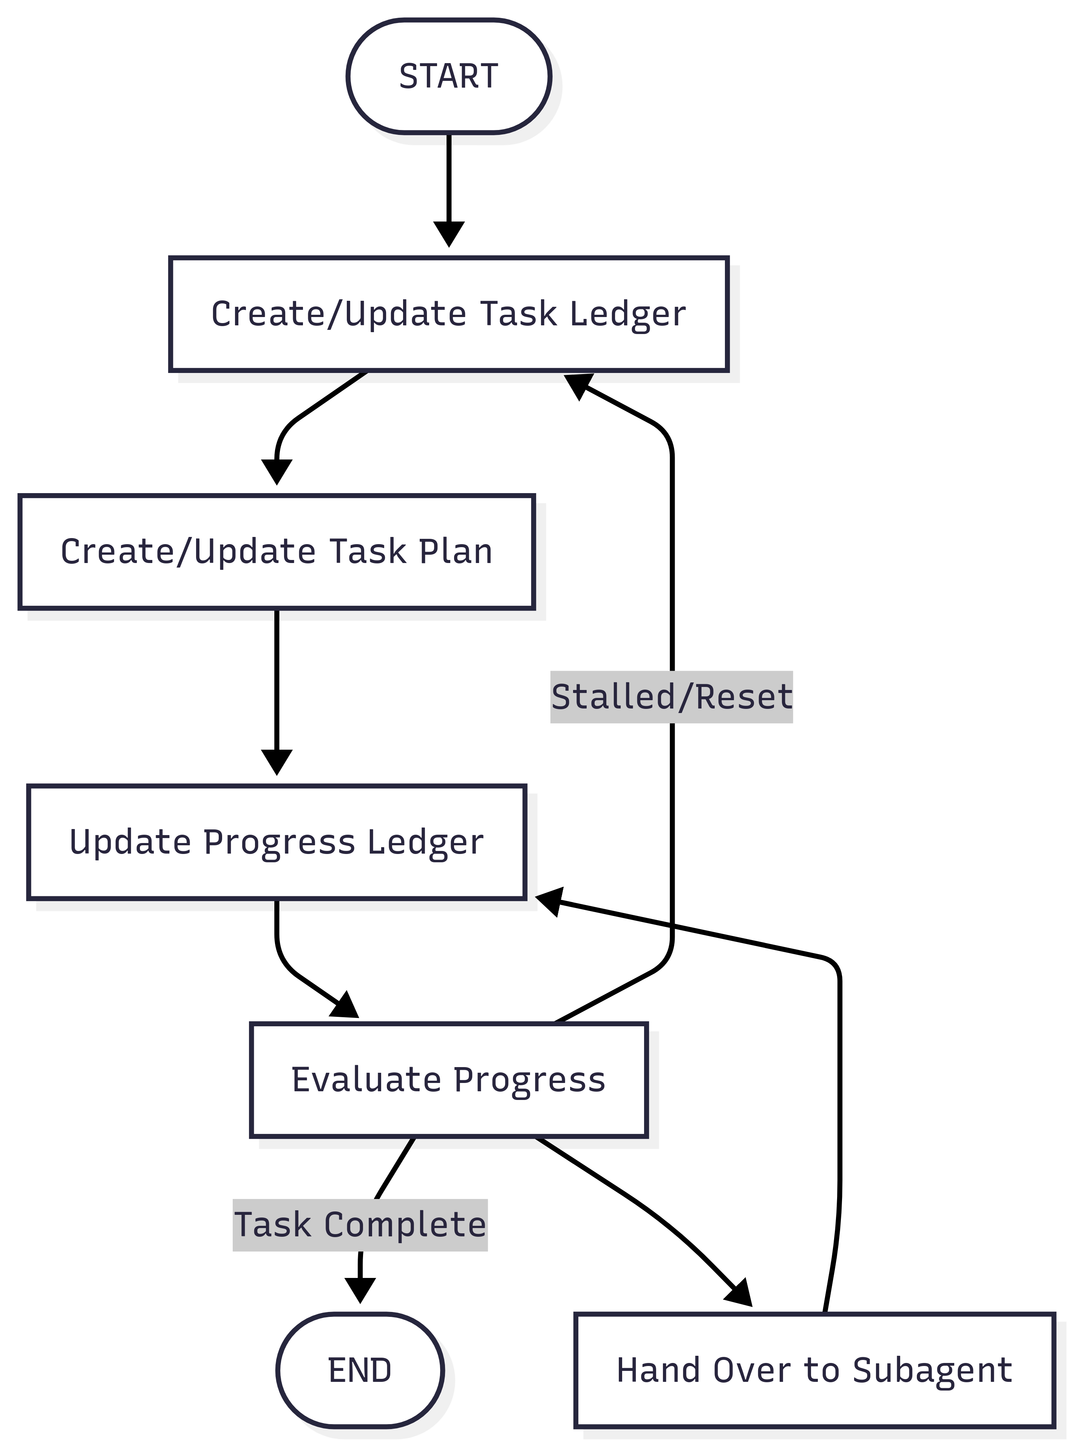
Implementation Stage 1: Single Task Architecture (Magentic-One - Microsoft Research AI Frontiers, 2024)

Slide 5
Implementation Stage 1: Learnings
LLMs can indeed perform large tasks with some success, but their effectiveness and reliability can improve by breaking the task into smaller subtasks
Deep research tasks increase the agent's context quickly, and the irrelevant context has a masking effect, so they benefit for summarization steps within the workflow

Slide 6
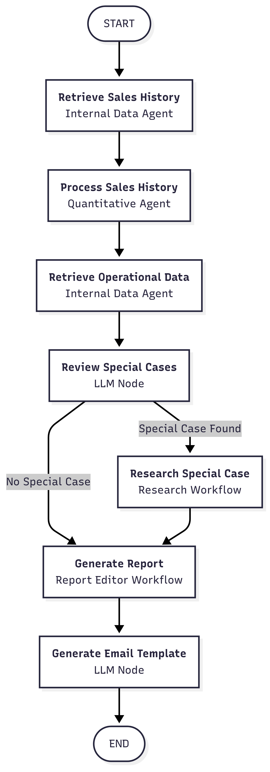
Implementation Stage 2: Workflow Architecture

Slide 7
Implementation Stage 2: Learnings
Autonomous agents are not guaranteed to self-recover, and the system must be planned around that.
Allow intermediate thinking steps
Steps to reflect and re-plan
When there is no clear measure for the task to be considered complete, it is important to create, and properly handle, forceful ending points.

Slide 8
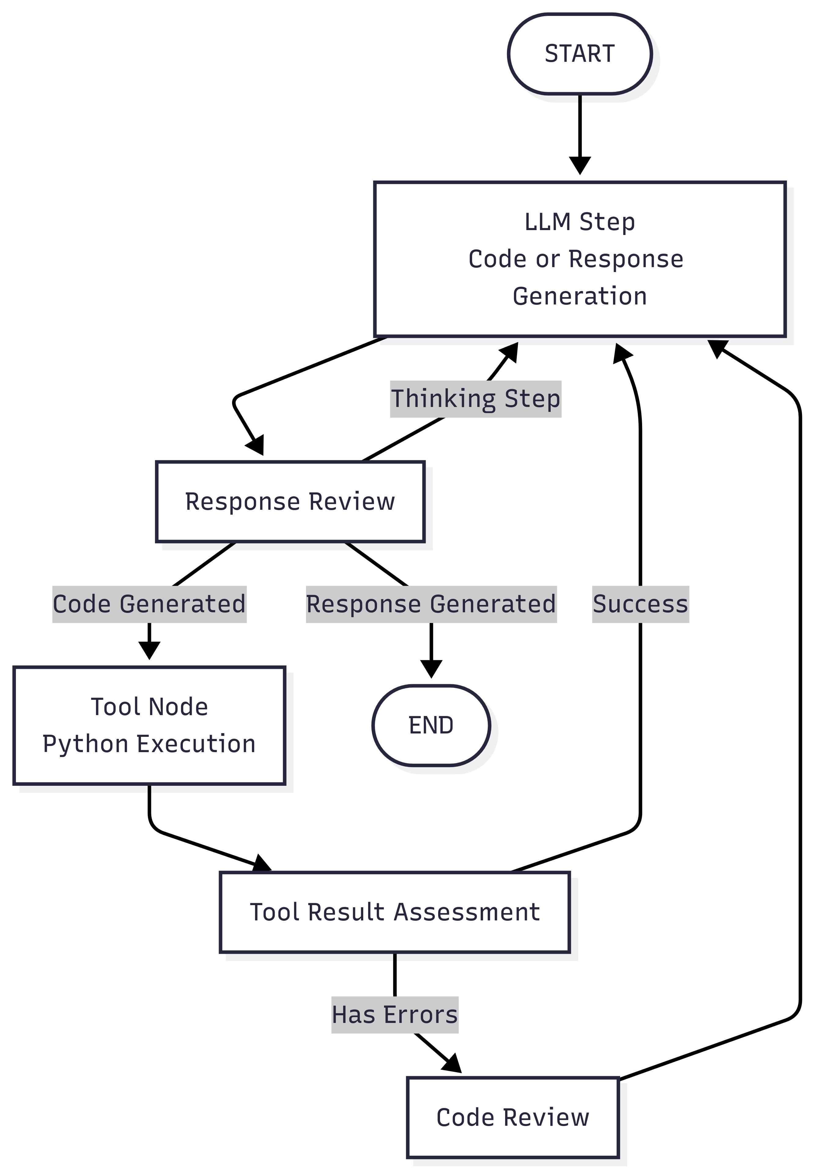
Implementation Stage 2: Coding Agent Architecture

Slide 9
Demo…

